Slide 1
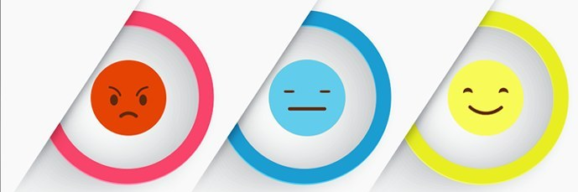
Sentiment analysis and image search USING twitter

Slide 2
Abstract
Analysis of public information from social media could yield interesting results and insights into the world of public opinions about almost any product, service or personality.
Sentiment Analysis or Opinion Mining is the computational treatment of opinions, sentiments and subjectivity of text.
Image search is a specialized data search used to find images using Web Scrapping. To search for images, a user may provide query terms such as keyword, image file/link, and the system will return images similar to the query.
In this project we will be discussing a methodology which allows utilization and interpretation of twitter data to determine public opinions and images.

Slide 3
introduction
Sentiment Analysis is the process of ‘computationally’ determining whether a piece of writing is positive, negative or neutral. It’s also known as opinion mining, deriving the opinion or attitude of a speaker.
Image search based on twitter is done using web scrapping method.
Web Scraping (also termed Screen Scraping, Web Data Extraction, Web Harvesting etc.) is a technique employed to extract large amounts of data from websites whereby the data is extracted and saved to a local file in your computer or to a database in table (spreadsheet) format.
In this project, we explore one method for building such data: using Twitter hashtags (e.g., #bestfeeling, #epicfail, #news) to identify positive, negative, and neutral tweets to use for training three-way sentiment classifiers.

Slide 4
Sentiment Analysis (opinion mining)
Sentiment Analysis is the process of ‘computationally’ determining whether a piece of writing is positive, negative or neutral. It’s also known as opinion mining, deriving the opinion or attitude of a speaker.
A basic task in opinion mining is classifying the polarity of a given text at the document, sentence, or feature/aspect level—whether the expressed opinion in a document, a sentence or an entity feature/aspect is positive, negative, or neutral. Advanced, "beyond polarity" sentiment classification looks, for instance, at emotional states such as "angry", "sad", and "happy".
Many traditional approaches in sentiment analysis uses the bag of words method. The bag of words technique does not consider language morphology, and it could incorrectly classify two phrases of having the same meaning because it could have the same bag of words. The relationship between the collection of words is considered instead of the relationship between individual words.

Slide 5
Cont.…
The objectives of this project are:
Sentiment Analysis to determine the attitude of the mass is positive, negative or neutral towards the subject of interest
Graphical representation of the sentiment in form of Pie-Chart, Bar Diagram, etc.
The main feature of our web application is that it helps to determine the opinion about the peoples on products, government work, politics or any other by analysing the tweets.

Slide 6
Image search (web scrapping)
Image search is a specialized data search used to find images using web scrapping. To search for images, a user may provide query terms such as keyword, image file/link, or click on some image, and the system will return images "similar" to the query.
Web Scraping (also termed Screen Scraping, Web Data Extraction, Web Harvesting etc.) is a technique employed to extract large amounts of data from websites whereby the data is extracted and saved to a local file in your computer or to a database in table (spreadsheet) format.
For scrapping Twitter, we need to setup a Twitter App. First of all, login from your Twitter account and go to Twitter Apps. Create a new app , go to Keys and access tokens and copy Consumer Key, Consumer Secret, Access Token and Access Token Secret.

Slide 7
Cont.…
The main advantages of web scrapping are:
Web scraping is used to collect a large set of data (Statistics, General Information, Temperature, etc.) from websites, which are analysed and used to carry out Surveys or for R&D.
Web scraping is used to collect data from Social Media websites such as Twitter to find out what’s trending.
Details regarding job openings, interviews are collected from different websites and then listed in one place so that it is easily accessible to the user.

Slide 8
modules
Only two modules are being available in this project:
User
Twitter API (Application Programming Interfaces)
The entire project is done with PYTHON as programming language and its modules.
Python is the best programming language to create and develop web scrapping and data mining related applications as it is well equipped with wide range of modules which makes it easier.

Slide 9
Twitter Api
Twitter is an American microblogging and social networking service on which users post and interact with messages known as "tweets". Registered users can post, like, and retweet tweets, but unregistered users can only read them.
To share information on Twitter as widely as possible, Twitter also provide companies, developers, and users with programmatic access to Twitter data through our APIs (application programming interfaces).
At a high level, APIs are the way computer programs “talk” to each other so that they can request and deliver information.
Twitter allows access to parts of our service via APIs to allow people to build software that integrates with Twitter, like a solution that helps a company respond to customer feedback on Twitter.

Slide 10
Python
Python is an interpreted, high-level, general-purpose programming language.
Its language constructs and object-oriented approach aim to help programmers write clear, logical code for small and large-scale projects.
Python is dynamically typed and garbage-collected. It supports multiple programming paradigms, including structured (particularly, procedural), object-oriented, and functional programming. Python is often described as a "batteries included" language due to its comprehensive standard library.
There are different kinds of modules available like matplotlib, tweepy, re, pandas, NumPy, etc..

Slide 11
Python Modules
A module is a file containing Python definitions and statements.
The file name is the module name with the suffix .py appended.
Definitions from a module can be imported into other modules or into the main module.
For example,
Tweepy is a module that enables Python to communicate with Twitter platform and use its API.
Matplotlib is a plotting library for the Python programming language which is used to plot graphs.

Slide 12
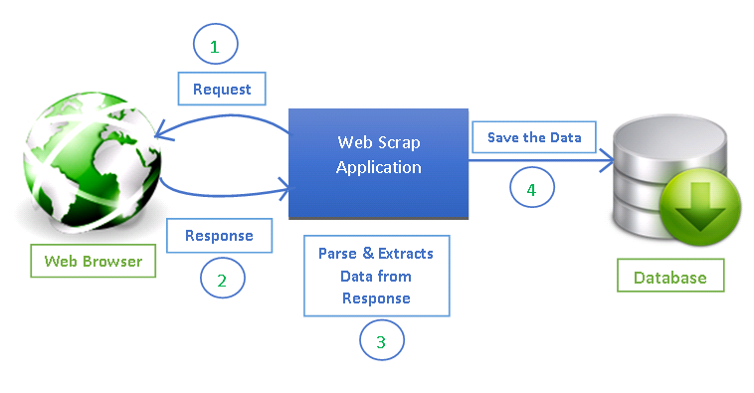
Web scrapping architecture

Slide 13
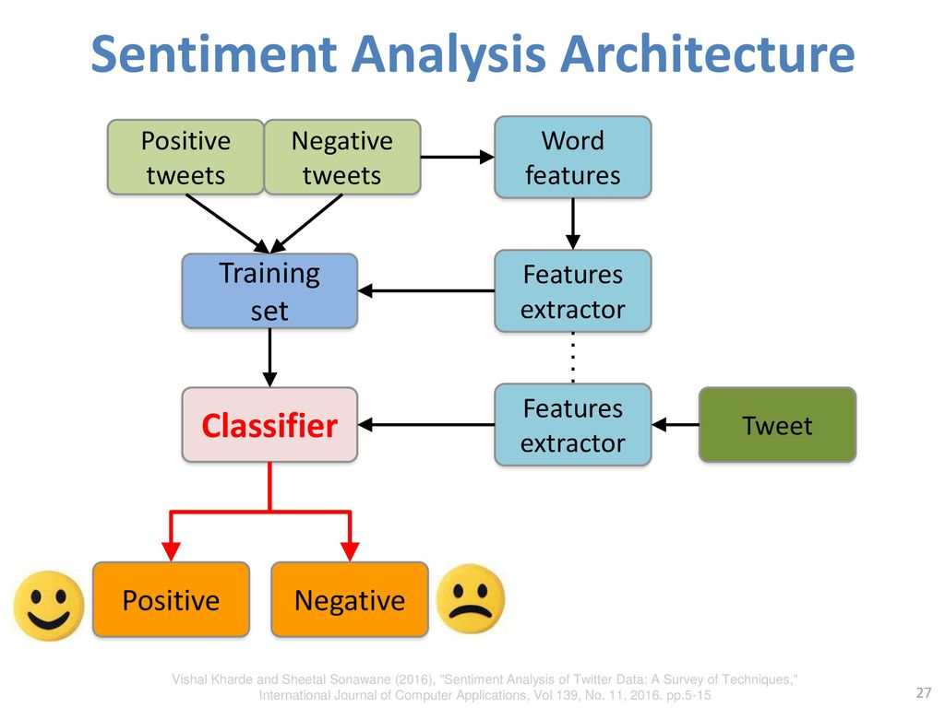
Sentiment analysis architecture

Slide 14
conclusion
Nowadays, sentiment analysis or opinion mining is a hot topic in machine learning. We are still far to detect the sentiments of s corpus of texts very accurately because of the complexity in the English language and even more if we consider other languages such as Hindi.
Data has become the basis of all decision-making processes whether it’s a business or a non-profit organization. Therefore, web scraping has found its applications in every endeavour of note in contemporary times.
It is also becoming increasingly clear that those who will make creative and advanced use of web scraping tool will race ahead of others and gain a competitive advantage. So, leverage web scraping and boost your prospects in your chosen area of endeavour!

Slide 15


